Slide 1
Information Design & Visual Strategy
Selected Works | Trial Demonstratives & Data Visualization
The following work has been sanitized to respect non-disclosure agreements and client privacy, preserving the original information hierarchies and visual logic while replacing all proprietary data with illustrative content. The diverse color palettes and aesthetic directions throughout this deck are intentional, demonstrating an ability to adapt visual strategies to specific project environments, brand identities, and the unique requirements of various litigation or corporate contexts.

Slide 2
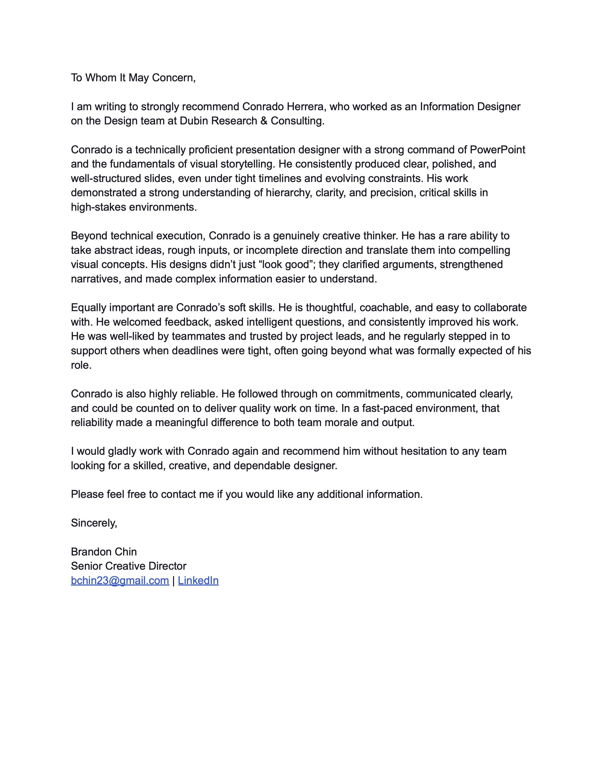
Recommendation Letter
February 1st, 2026
Recommendation Letter
Recommendation Letter by Brandon Chin, Senior Creative Director

Slide 3
STEPS TO DEVELOP SOFTWARE
CONCEPTION OF IDEA
SYSTEM ARCHITECTURE AND DESIGN
FRONTEND AND BACKEND DEVELOPMENT
TESTING
PRODUCT LAUNCH

Slide 4


PLAINTIFF’S AGREEMENT WITH AIRPLANE OPERATORS
COMPANY B
COMPANY A

Slide 5


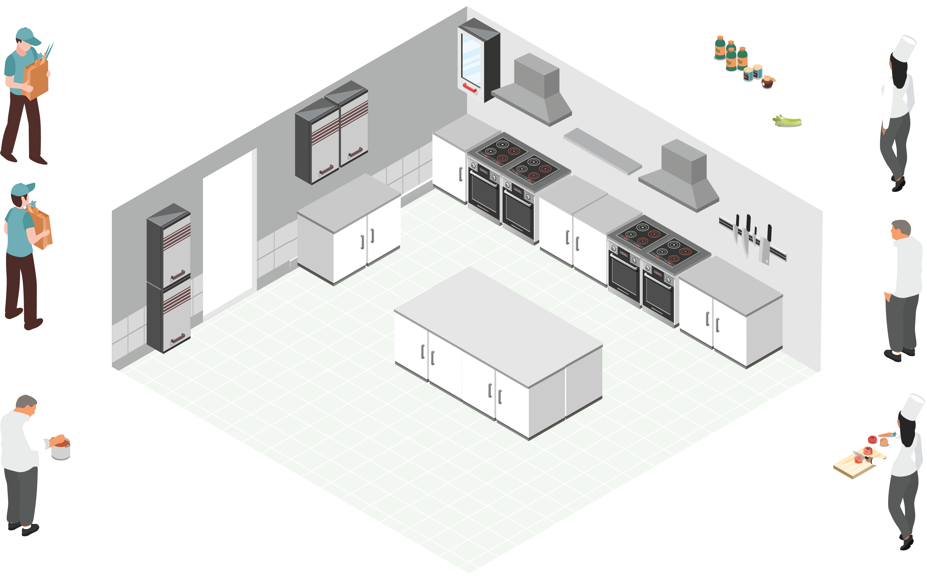



SUPPLIERS
RECIPES
RECIPE
RECIPE
1
RECIPE
1
RECIPE
2
2
3
1
3
1
4
2
4
2
3
3
4
4
$
$
$
ORDERS
THE KITCHEN
BACK END
≈
THE COUNTER
FRONT END

Slide 6








DEFENSE CUSTOMERS
GROWERS
PRE-COOL/PACKHOUSE
RETAILER
SHORTER
SHELF-LIFE
0% REJECTIONS
IMPRECISE ROUTING
LONGER
SHELF-LIFE
SMARTER ROUTING
18%
0%

Slide 7




DIRECT EVIDENCE
CIRCUMSTANTIAL EVIDENCE

Slide 8
PROJECT DELTA: DEVELOPMENT & RELEASE ROADMAP
DEC
Development team initiates the Alpha testing phase for core system architecture.
AUG 26
Project Delta transitions from "Active Development" to "Long-term Support."
APR 11
Completion of the Alpha phase and transition to third-party security audit.
AUG 24
Final Q3 performance analytics compiled for executive stakeholder review.
DEC-APR
Comprehensive stress testing and internal vulnerability assessments conducted across all primary modules.
DEC
JAN
FEB
MAR
APR
MAY
JUN
JUL
AUG
2024
2025
JUN-AUG
Focused development sprints on multi-platform optimization
APR 24-25
Beta Build 4.0 released to internal testers; identified critical integration conflicts.
AUG 7
Global launch of Version 5.0 across all designated international regions.
APR 28
Beta Build 4.0 withdrawn; previous stable environment restored for debugging.
AUG 8 & 12
Tiered rollout of Version 5.1 updates for Enterprise and Premium subscribers.

Slide 9
REVENUE MODEL STRATEGY
FISCAL OPTIMIZATION
RECURRING
TRANSACTIONAL
SUBSCRIPTION MODEL
SINGLE
PURCHASE FEE

Slide 10
BAR CHART EXAMPLE

Slide 11


Thank you
Conrado | Information Designer & Visual Strategist
design@conrado.cloud
conrado.cloud

